Slide 1
Social prescribing

Slide 2
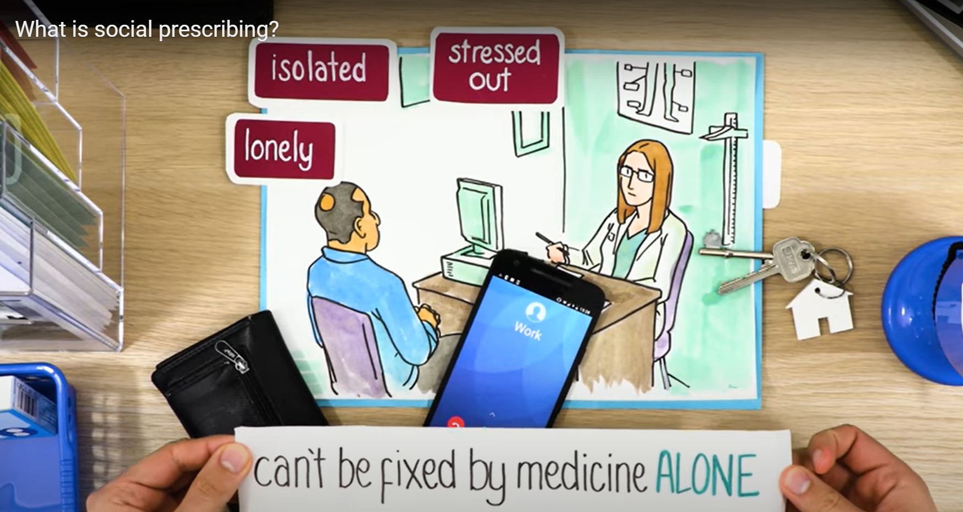
What is Social prescribing?
What is social prescribing? - YouTube

Slide 3
What does Social prescribing support look like?
Call you and have a chat to find out a little more about the support you want.
Either;
signpost providing information on services and activities in the local area. If you only want information and advice to take away with you
OR
Be allocated a worker who would complete an informal assessment finding out what is important to you and what you feel you need support with.
Create an action plan and support you to meet the actions agreed.

Slide 4
Housing
Homelessness
Damp/ disrepair
Housing legal advice
Housing benefit, council tax, rent arrears
Utility Priority list
Funding - white goods
Improving energy efficiency
Housing issues
HOST – Housing options Trafford Council
Shelter - Shelter services in Manchester - Shelter England
CAB - Citizens Advice (casort.org)
Green Doctor – energy advice - Green Doctor, helping UK residents stay warm, stay well, and save energy. – Groundwork
Energy companies
Warm Rooms initiative
LEASE – free legal advice for leaseholders
Notes:
Example – frequent attender with cold, flu, chest symptoms – could be damp or cost of living, broken boiler

Slide 5
Finances
Finances
Employed/unemployed/retired
Benefits in receipt of and/or maybe eligible for
Outstanding debts through creditors ( legal) or loan sharks ( illegal)
Outstanding debts identified through assessment council tax, rent arrears
Spending appropriately/managing money/budgeting
CAP UK | Home – debt Support service
StepChange Debt Charity - Free Expert Debt Advice.
Debt advice | Free debt advice | National Debtline | National Debtline
Business debt line
Who we are - England Illegal Money Lending Team (stoploansharks.co.uk)
Budgeting course
Welfare rights Trafford council
Welfare rights and money teams under housing providers.
Bread and butter thing
Food bank
Citizens advice
Notes:
Someone presenting to PTSD not able to get employments difficult to organise self attend meetings, manage money or appointments. Given medication for PTSD but getting to the route cause of finances, that added stress. - Cancer specialist welfare rights.

Slide 6
Health
Dementia café
Alzheimer's
Parkinson's
Cancer specialist welfare rights team
Health hips and heart
Chair based Yoga at Altrincham library
Pulmonary rehabilitation
Water wellness
Trafford leisure
British heart foundation – exercise classes
Stroke association
Trafford carers
Autism group
Yoga for sleep difficulties
Self-care
Specialist Services for specific health conditions
Impacts on daily activity
Peer support
Tools to manage health condition
Isolation
inactivity
Mobility
Weight
Notes:
walking buddy

Slide 7
Mental health and wellbeing
Substance misuse / dial diagnosis
Bereavement
Sleep loss
Childhood Trauma
Domestic abuse
Menopause
Low mood low motivation
Anxiety and depression
Trauma
Mental health diagnosis
Work difficulties
Beyond barriers
Mindfulness sessions
Green nature based volunteering
Counselling and family centre
Self help services – Anxiety groups
IAPT
Achieve
Cruse counselling
Age UK
Menopause group
ACAS – free Employment Law service
Blue-sci – Broomwood centre and Coppice Library
Trafford domestic abuse service
Notes:
Anxiety and depressions – after doing a holistic assessment and sending time, the route cause to the anxiety and depression, drinking alcohol from past trauma and domestic abuse.

Slide 8
Lifestyle and looking after yourself
Getting out – mobility, transport
Unhealthy habits
Washing and bathing
Dressing
Smoking
drinking
substance misuse
Inactive
Weight
Shopping
The hub – shopping
Walking buddy
Community meal
Adult social care
Achieve
Equipment and adaptations
Travel concessions
Ring and ride. Travel vouchers,
Blue badge
Notes:
Signposted triage patient – wasn’t sure waat we could help with after a long call - lived in rural area and was dependent on other to give her lifts. Discussed ring and ride and concessionary bus pass. Due to health condition she would be eligible for. she said she would be able to complete online application by herself and happy for me to send this information over. she said she was really happy with the call as she wasn’t aware of these things. Help with staying independent.

Slide 9
Meaningful activities
Interests past and present
Work/volunteering
Education and training
Activities
Hobbies,
Groups
Being more Active
Reduce isolation
Building support networks
Craft groups
Art groups
Allotments
Interest groups
Physical activity -
Coffee mornings and lunch groups
Walking groups / walking buddy
Walking football and netball
Employment services
Volunteering champion
Notes:
Louise – allotment

Slide 10
Summary
Social prescribing is a non-medical model
Support is person-centerd around you
We provide time to find out what’s going on for you
We look at different areas in your life that might impact on each other
We would support you to access services and activities to meet your needs and help manage you health and wellbeing.
Notes:
Louise – allotment

Slide 11
How to access the social prescribing service
Using our online referral form - Social Prescribing Self-Referral – Altrincham Healthcare Alliance PCN
Speak to your GP reception team or medical staff under the practice.
Email - trccg.socialprescriberahapcn@nhs.net

