Slide 1
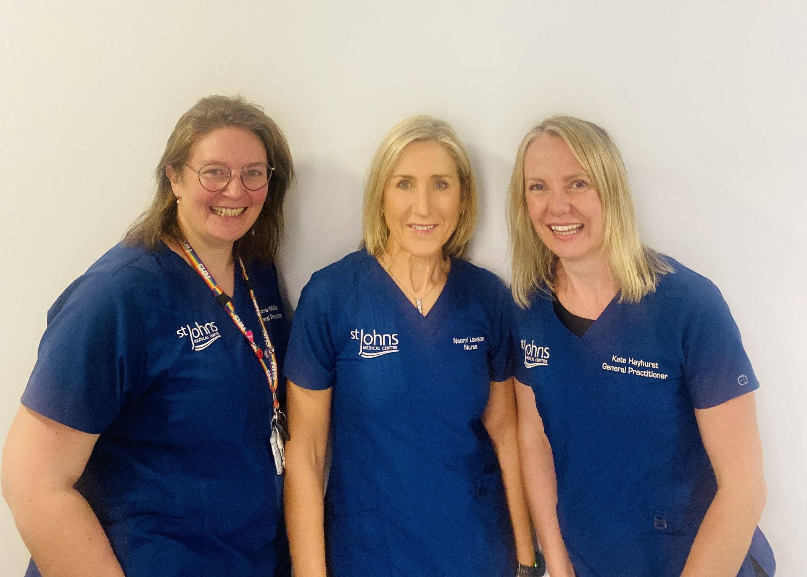
SJMC Research
Dr Lorna McCune – GP Research Lead
Naomi Lawson – Research Co-ordinator
Dr Kate Hayhurst – Study Principle Investigator

Slide 2
Benefits of Research in Primary Care
Research is a core function of the NHS
Patients get access to new treatments, interventions and medicines
Brings new dimension to practice and added skills to those involved
Investment in research means better, more cost effective care for patients
‘the NHS pledges…..to inform you of research studies in which you may be eligible to participate’

Slide 3
Why get involved?
learn more about a condition that affects you
make a difference, by helping to improve treatments and quality of life, now and for future generations
support medical research for a particular condition or disease that you care about
access new treatments
take an active role in your own care.

Slide 4
SJMC Studies
BCAN Ray - Breast CANcer Risk Assessment in Younger women
ID Liver - Diagnostics for Early Diagnosis of Liver Disease
Discover Me - nationwide research study looking at how health and genetic information can allow us to better understand disease.
SPIRIT Victorion - A study to evaluate the delivery of Inclisiran in primary care

Slide 5
NIHR Clinical Research Network (CRN)
Collaborate with CRN Primary Care to deliver Portfolio Studies
Research Champions

Slide 6
NIHR Clinical Research Network (CRN)

